Slide 1






Intermediate Outcomes for health System Performance for UHC Session 2a Global Flagship Course on Health Systems Strengthening: The Challenge of Universal Health Coverage Thomas J. Bossert, Ph.D. Harvard T.H. Chan School of Public Health

Slide 2
Intermediate Outcomes
Are more closely related to changes in health system than ultimate objectives which may be influenced by many other conditions
Our choice:
Access
Quality
Efficiency

Slide 3
Both Average Performance And Equity Matter In Judging Outcomes
Averages may conceal big variations in outcomes
Various kinds of group differences may matter: age, sex, income, location, ethnicity
Not all differences in health come from differences in health care: social and economic factors may be key

Slide 4
In Identifying Problems Consider the DISTRIBUTION/Range of Outcomes
 | Average | Distribution
Health Status | LE 64 years | Rural have lower LE
Customer Satisfaction | Moderate Satisfaction | Poor are more dissatisfied
Financial Protection | OOP is 30% of THE | Poor pay higher % of income
To think about distribution ask: are there
specific groups who do noticeably less well
on outcomes we care about?

Slide 5
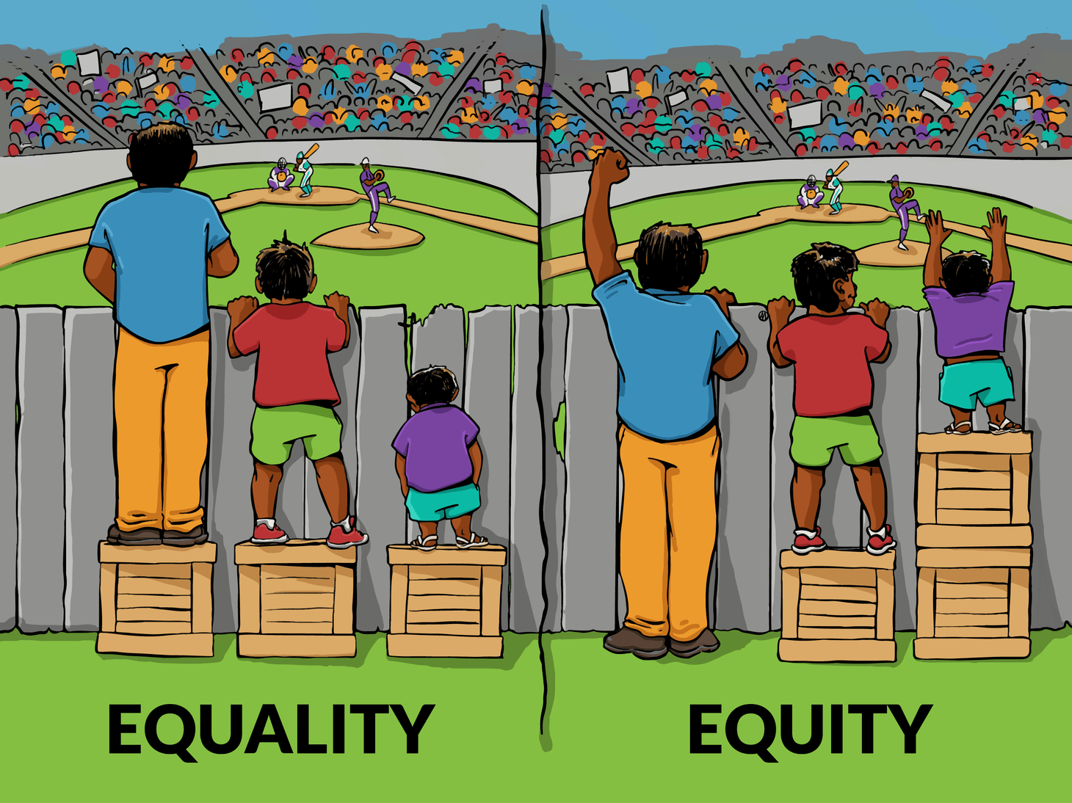

Slide 6
Measuring Equity
Different countries have different values on equity
Differences in rich and poor: “Relative equity”
:How badly off are the poor: “Absolute equity”
Chile:
One of the worst GINI coefficients (difference between rich and poor)
But reduced poverty from 40% to 13%

Slide 7
Equity issues in Armenia
What indicators do you have of differences between urban and rural health status?
Do you have data on differences by income quintiles?
Are there special religious or ethnic group differences?

Slide 8
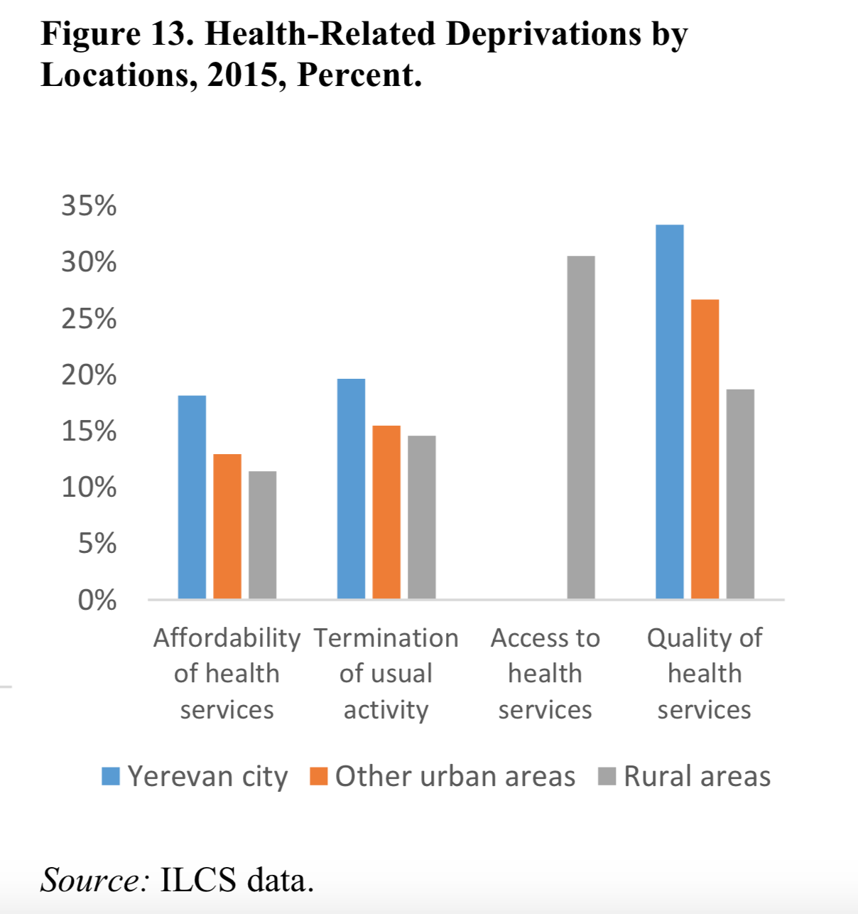
Health related deprivations show inequities across regions are pervasive
Greater deprivations in affordability in urban areas persist (20% in Yerevan and above 10% in rural areas)
Inequities in access to health services are persistent in rural areas (more than 30% of people living in rural areas don’t have access to health service)
Notes:
Deprivation: deprivations refer to areas of human development where gaps in endowment are often persistent over time and negatively influence the future capacity of a household to escape poverty and vulnerability. Thus, the choice of dimensions of deprivation aims at
complementing the monetary poverty measure with others that have a non-pecuniary value
« the lack or denial of something considered to be a necessity.”

Slide 9
What access issues are important in Armenia?
How do you measure them?

Slide 10
Clarifying “Access”
Access is often measured in terms only of supply side availability of services. For instance, the number of hospital beds per population. Or utilization statistics: number of consultations per physician.
However, “effective access” combines both the expert assessment of need with the patients or demand side, and therefore also considers what patients want and what appear to be barriers to use, including disrespectful care.

Slide 11
Factors that Influence Access
Physical availability: Is the service available at a reasonable distance from all potential patients? Is there public transportation?
Effective availability: Are there barriers to patients who want to use the service?
Payment (formal or informal)
Limited service hours
Appointment delays
Waiting times
Staff attitudes
Cultural appropriateness

Slide 12
There is often a gap between “use” and “need”
Need
Demand
Use
Epidemiology
Economics
Evaluation
Gap
Source: P Musgrove
Notes:
SARAH –
Need- how do we measure need for HIV? …..
Prevalence rates…..
Need for
Antenatal care……good practice to have 4 visits….. – if demand is low, use will be low and that is the gap – can evaluate to show where the problem is……
Immunization – 0-1 – policies around this; demand low…….
TB – 40% not getting treatment……- demand…

Slide 13
Barriers to accessing health services with specification of supply and/or demand influence: D = demand side; S = supply side
Source: Adapted from Peters et al. (2008) and Ensor and Cooper (2004).
Notes: D = demand side; S = supply side.
Dimension of barriers (Peters et al. 2008) | Barriers (Ensor and Cooper 2004)
Geographic accessibility
Service location (S) | Indirect costs to household (transport cost) (D)
Household location (D)
Availability
Health workers, drugs, equipment (S) | Waiting time (S)
Demand for services (D) | Wages and quality of staff (S)
 | Price and quality of drugs and other consumables (S)
 | Information on health care choice/providers (D)
 | Education (D)
Affordability
Costs and prices of services (S) | Direct price of service, including informal fees (S)
Household resources and willingness to pay (D) | Opportunity costs (D)
Acceptability
Characteristics of the health services (S) | Management/staff efficiency (S)
User’s attitudes and expectations (D) | Technology (S)
 | Household expectations (D)
 | Community and cultural preferences, attitudes, and norms (D)

Slide 14
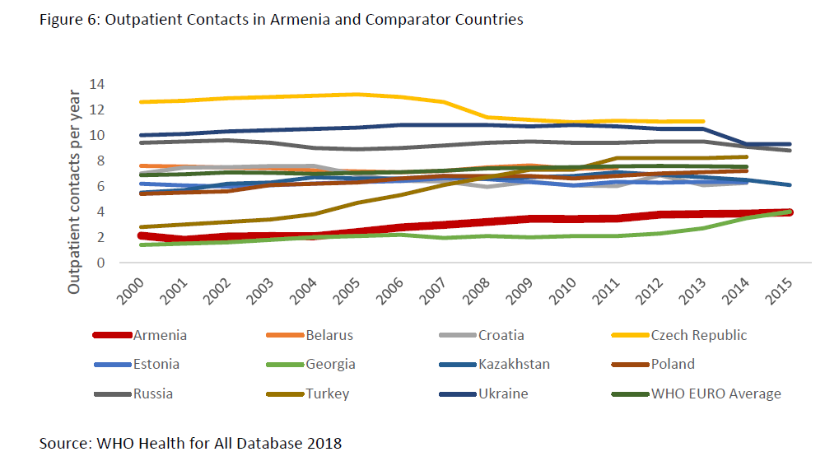
Possible indicators of Access Problems

Slide 15
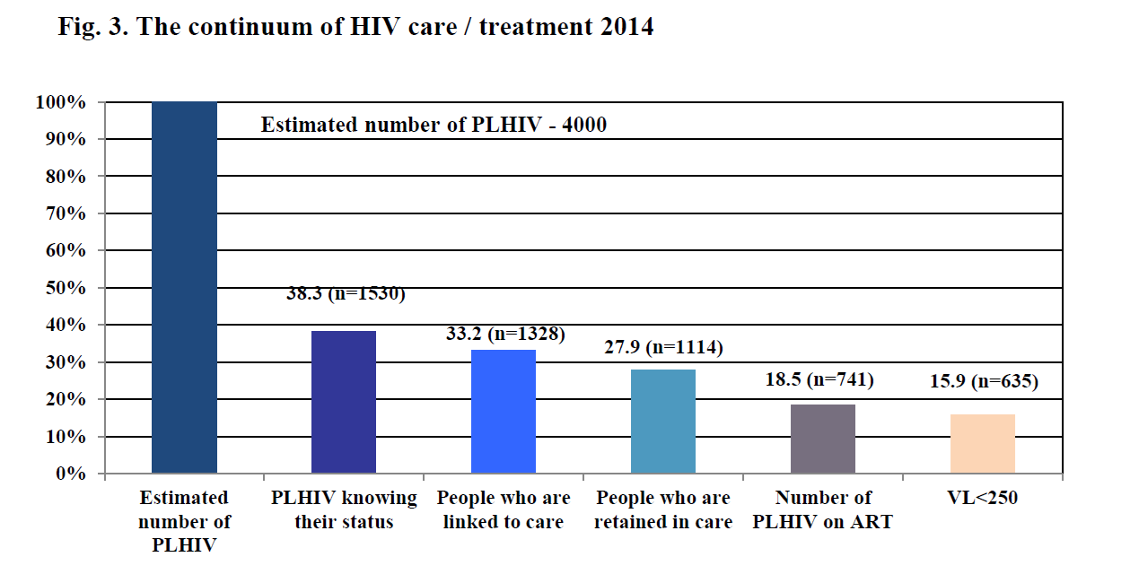
Indicator of Access problem in Armenia

Slide 16
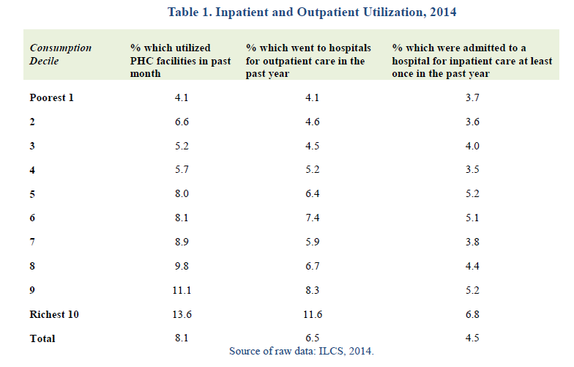
In Armenia there are large inequities in utilization across income deciles
The population continues to prefer specialist care. despite efforts to promote family medicine (GP registration of around 98%).
Notes:
Source: Hayrapetyan, Susanna; Kharazyan, Samvel; Lavado, Rouselle F.. 2018. Expansion of the benefits package : the experience of Armenia (English). Universal health coverage study series; no. 27. Washington, D.C. : World Bank Group. http://documents.worldbank.org/curated/en/615741516195329170/Expansion-of-the-benefits-package-the-experience-of-Armenia

Slide 17
What Quality Issues are important in Armenia?
How do you measure them?

Slide 18
Quality is Multi-Dimensional
Quality is not one thing—it is many things—many different dimensions of performance
Different patients and providers will care about different aspects of a good or service
Many factors including patient demand, budgets, incentives, organization, motivations, skills, regulations limit the potential level of quality – but most health care providers are not doing as well as they could.
Reformers need to understand which quality dimensions are most important

Slide 19
Aspects of Health Care Quality
Two aspects of health care quality:
Clinical quality: providing the right kind of care and skilfully carrying out the care process
Service quality: providing hotel services, amenities, convenience, courtesy, emotional support
Health outcomes largely depend on clinical quality
Citizen satisfaction responds more to service quality
Improving service quality can often help improve clinical quality by fostering patient cooperation

Slide 20
Lancet Commission on High Quality
“Progress on UHC should be measured through effective (quality-corrected) coverage.”
“Poor-quality care is now a bigger barrier to reducing mortality than insufficient access.”
“Measurement is key to accountability and improvement, but available measures do not capture many of the processes and outcomes that matter most to people.”

Slide 21
Lancet Commission: Four Universal Actions
“health system leaders need to govern for quality by adopting a shared vision of quality care, a clear quality strategy, strong regulation, and continuous learning”
“countries should redesign service delivery to maximize health outcomes rather than geographical access to services alone.”
“countries should transform the health workforce by adopting competency-based clinical education, introducing training in ethics and respectful care, and better supporting and respecting all workers to deliver the best care possible.”
“governments and civil society should ignite demand for quality in the population to empower people to hold systems accountable and actively seek high-quality care.”

Slide 22
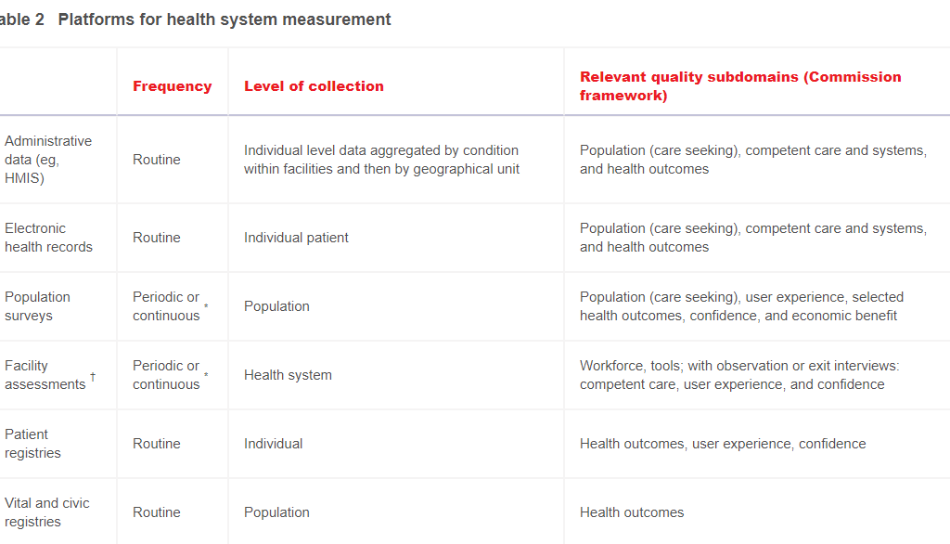

Slide 23
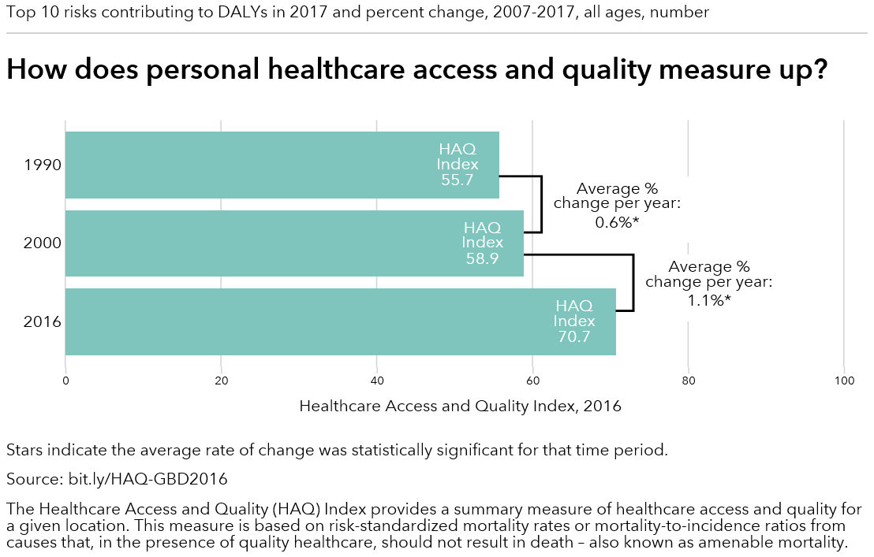
Quality and Access in Armenia

Slide 24
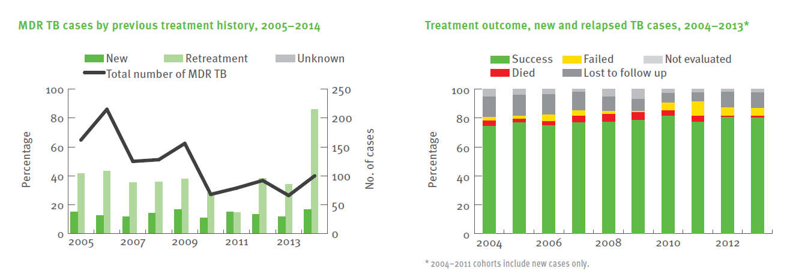
Indicators of TB that might indicate quality in Armenia

Slide 25
What Efficiency issues are important in Armenia?
How do you measure them?

Slide 26
Efficiency
Using your limited resources
in the best possible way
to achieve your goals

Slide 27
Main sources of inefficiency
Doing the wrong things
Services with low cost-effectiveness (CE)
Wrong mix of preventative vs. curative services
E.g., not enough services with high CE
Doing things in the wrong places
Provision of services at high-level institutions that could be offered at lower level care
Lack of mechanism to ensure continuity of care
Spending badly
Inputs
Too few generics or paying too much
Over-or-under capacity of infrastructure
Inappropriate mix of personnel
Inappropriate mix of inputs (e.g., health workers but no medicines)
Outputs and outcomes
Unnecessary tests, procedures, visits, length of stay
Medical errors and low quality care
Health Financing and Health System Organization
Waste, corruption, fraud
Fragmentation
Administrative inefficiency, low budget execution rate, poor PFM
1
2
3
Notes:
SUSAN – DON’T GO THROUGH ALL – JUST EXPLAIN THAT THIS IS FOR DISCUSSION IN GROUPS
Example: high burden of care of vaccine preventable illnesses. Doing too little of something can also be an inefficiency……For example, we know that vaccines are one of the most cost-effective interventions. Yet, in Laos,
GROUP WORK….

Slide 28
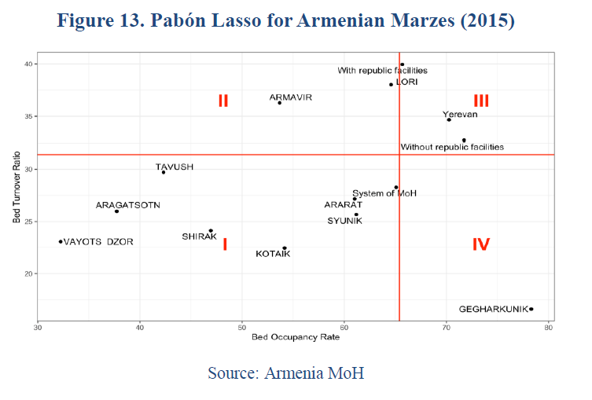
Efficency improvements are in progress through hospital optimization in Armenia
Armenia has experienced gains in efficiency through hospital optimization (hospital mergers, downsizing of bed capacity and elimination of redundant spaces and services).
Between 2005 and 2011, Armenia achieved a 40 percent reduction in public hospitals,
However, country’s hospitals in a majority of regions have an excess capacity of beds and low utilization leading to inefficiencies in the health system.
This shows efficiencies could be gained without additional funding.
Notes:
Quadrant 1: excess of beds and low utilization Quadrant 2: excess of beds and high utilization
Quadrant 3: Good performance, small proportion of unused beds
Quadrant 4: lack of beds and high utilization: Large proportion of severe cases, predominance of chronic cases

Slide 29
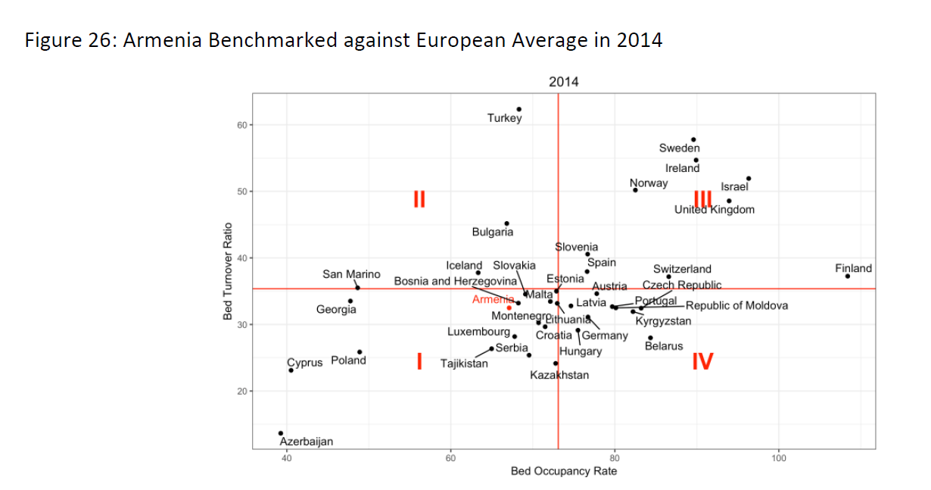
Occupancy and Turnover in comparative terms

Slide 30
Efficiency
Technical
Efficiency
Allocative
Efficiency

Slide 31
Efficiency
Technical
Efficiency
Producing outputs at minimum (unit) cost (“Best Bang for the Buck”)
Depends upon how things are produced
Largely determined by managers and workers

Slide 32
Efficiency
Allocative
Efficiency
Producing the right set of outputs to achieve your goals
A function of what things are produced
Managers’ decisions are influenced by regulators, planners, payers , budget setters etc.

Slide 33
Pursuing Technical Efficiency
Improving technical efficiency lowers cost without reducing quality
This increases the amount of services at the same or better quality that can be provided for a given budget—potentially improving both health and citizen satisfaction (but only if quality is adequate or excellent)
Units:
$ per DALY
more patients seen per day by same number of providers at same salary

Slide 34
Examples of Technical Efficiency Questions
Are we immunizing more children per dollar spent on vaccines and on salaries of health workers?
Do we assign the right number of physicians of different specialties to each clinic so all are fully utilized?
Do we use generic drugs where appropriate?
Do we avoid staffing and maintaining unused beds and under-utilized diagnostic equipment?

Slide 35
How do you improve technical efficiency?
Manage employees to improve their productivity
Centralize services to fully utilize facilities that have high ‘economies of scale’
Manage the supply chain to avoid leakages, stock outs and expired drugs and vaccines
Ensure that care complies with clinical guidelines
Improve purchasing of vaccines and drugs
Notes:
Manage employees to improve their productivity: Ex reduce absenteeism
Centralize services to fully utilize facilities that have high ‘economies of scale’ (e.g. radiation treatment for cancer)
Manage the supply chain to avoid leakages, stock outs and expired drugs
Ensure care complies with clinical guidelines: Use of nurses and physicians assistants

Slide 36
Pursuing Allocative Efficiency
Better allocative efficiency is especially critical for improving heath outcomes
It results in a more cost-effective mix of outputs to address the main performance problems of a health system

Slide 37
Examples of Allocative Efficiency Questions
Do we spend enough on immunization - which is very cost effective - to maintain its impact?
Do we avoid spending a great deal on a few very high cost patients who get little health gain as a result?

Slide 38
Monitoring Allocative Efficiency
Allocative efficiency evaluation requires comparative cost-effectiveness analysis
Studies from other countries need to be used carefully. May not apply.
Cost data are often poor (e.g. prices not costs)
Input costs vary among countries
Comparing very different kinds of services requires us to measure outcomes with a single index

Slide 39
How do you improve allocative efficiency?
Provide effective ‘primary prevention’– immunization, lower tobacco use, improve diet etc.
Provide effective primary care management of chronic NCDs to decrease costly acute events
Provide appropriate HIV/AIDS, TB, hypertension, diabetes, and cancer screening to increase effectiveness of treatment through early detection

Slide 40
Sustainability of Achievements
Do not assume that achievements in indicators of intermediate objectives will be sustained
In USA measles was eliminated but now there are new outbreaks because immunization coverage fell below herd immunity levels
Sustainability depends on continued:
Funding at sufficient levels
Training and retraining of human resources
Planning and priority of activities that are needed
Continued monitoring of intermediate indicators

Slide 41
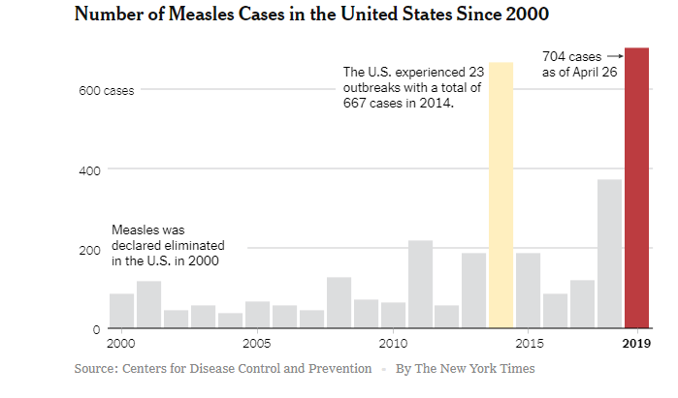
Sustainability of Measles elimination in USA

Slide 42
Some Take-Away Points
Improving performance on intermediate outcomes is critical for achieving the health and financial protection goals of UHC
Tracking intermediate outcomes is critical to insure reforms are being effectively implemented and sustained
Creating reliable reporting systems is necessary but not sufficient for improving performance

